Slide 1
Mastering Data Security with DSPM: A Data-First Approach
by Agata Crowley 16/07/2024

Slide 2









Slide 3
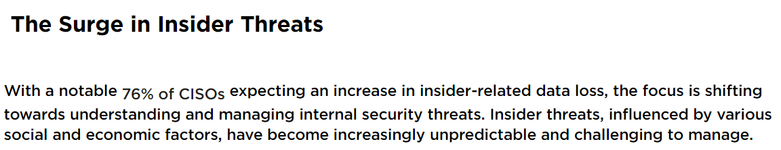
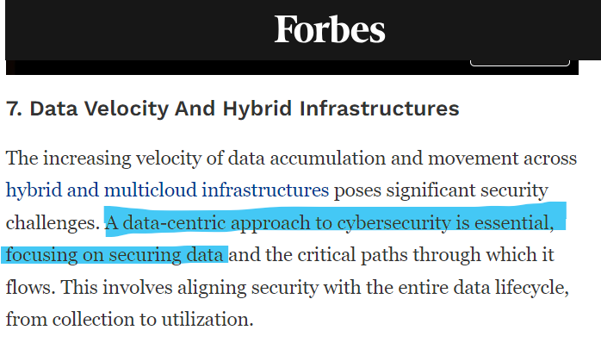
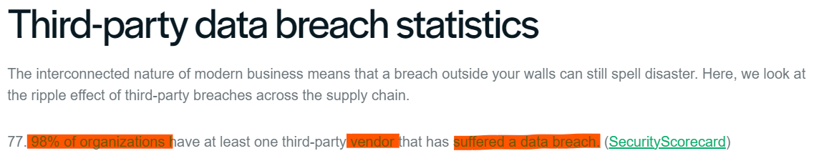
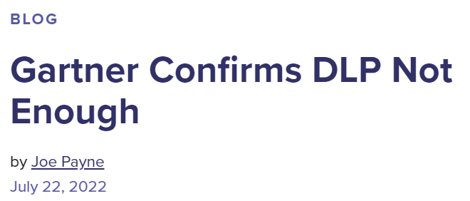
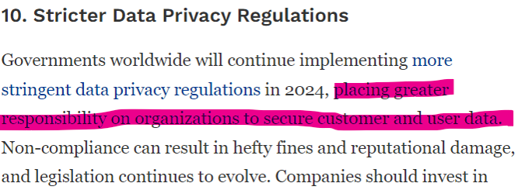
Data Security Landscape

Slide 4
DATA

Slide 5
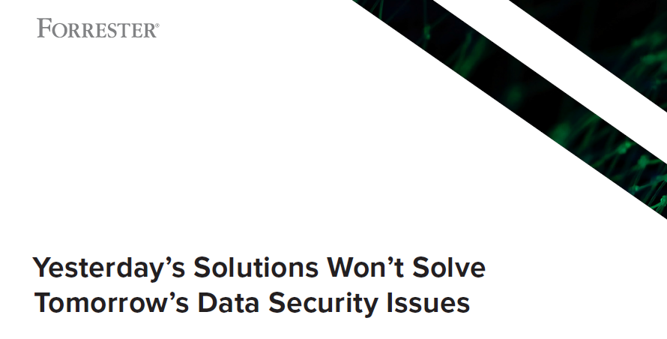
Why?

Slide 6
Traditional security tools fall short of adequately securing data due to several critical limitations.
Context/ Value
Interpretation
Inter-tool Blindness
Metadata
Orchestration
Notes:
Lack of Contextual Understanding
Issue: Security tools often struggle due to their incapacity to grasp the context or value of data.
Impact: Inability to prioritize protection based on data sensitivity or business importance.Inconsistent
Data Interpretations
Issue: Security tools such as SIEM, EDR, IAM, and FW have different interpretations of data.
Impact: Leads to fragmented security measures and gaps in overall protection.
Inter-tool Blindness
Issue: Products are blind to each other's interactions at the data layer.
Impact: Hinders the ability to detect and respond to complex, multi-vector attacks effectively.
Insufficient Metadata Analysis
Issue: Security tools cannot analyze metadata comprehensively for advanced and proactive defense measures.
Impact: Misses out on critical insights that could prevent sophisticated threats.
Challenges in Orchestration
Issue: Effective orchestration of data security is challenging.
Impact: Data Loss Prevention (DLP) on its own is not enough to ensure comprehensive security.

Slide 7

The Biggest Challenge
15%
Data You Know About
Data You Don’t Know About
Unseen
Unknown
Unidentified
Undiscovered
85%
Notes:
UnKNOWN – Backups, Misconfigured, Data Residency, M&A Data
UnIDENTIFIED – Source Code, Sprawl Data, Dark Data, Business Plan Data
UnDISCOVERED – Test Data, Log Data, Duplicates, Temporary Working Files, ROT Data Redundant (duplicates/multiple copies), Obsolete(outdated info, no longer used, files used by ex-employes), Trivial (insignificant files, not related files e.g. employees' personal files)

Slide 8

What can help us solve today’s data security issues?

Slide 9

Data Security Posture Management
Security and risk management leaders should use a strategic roadmap to capitalize on data security strategy.

Slide 10

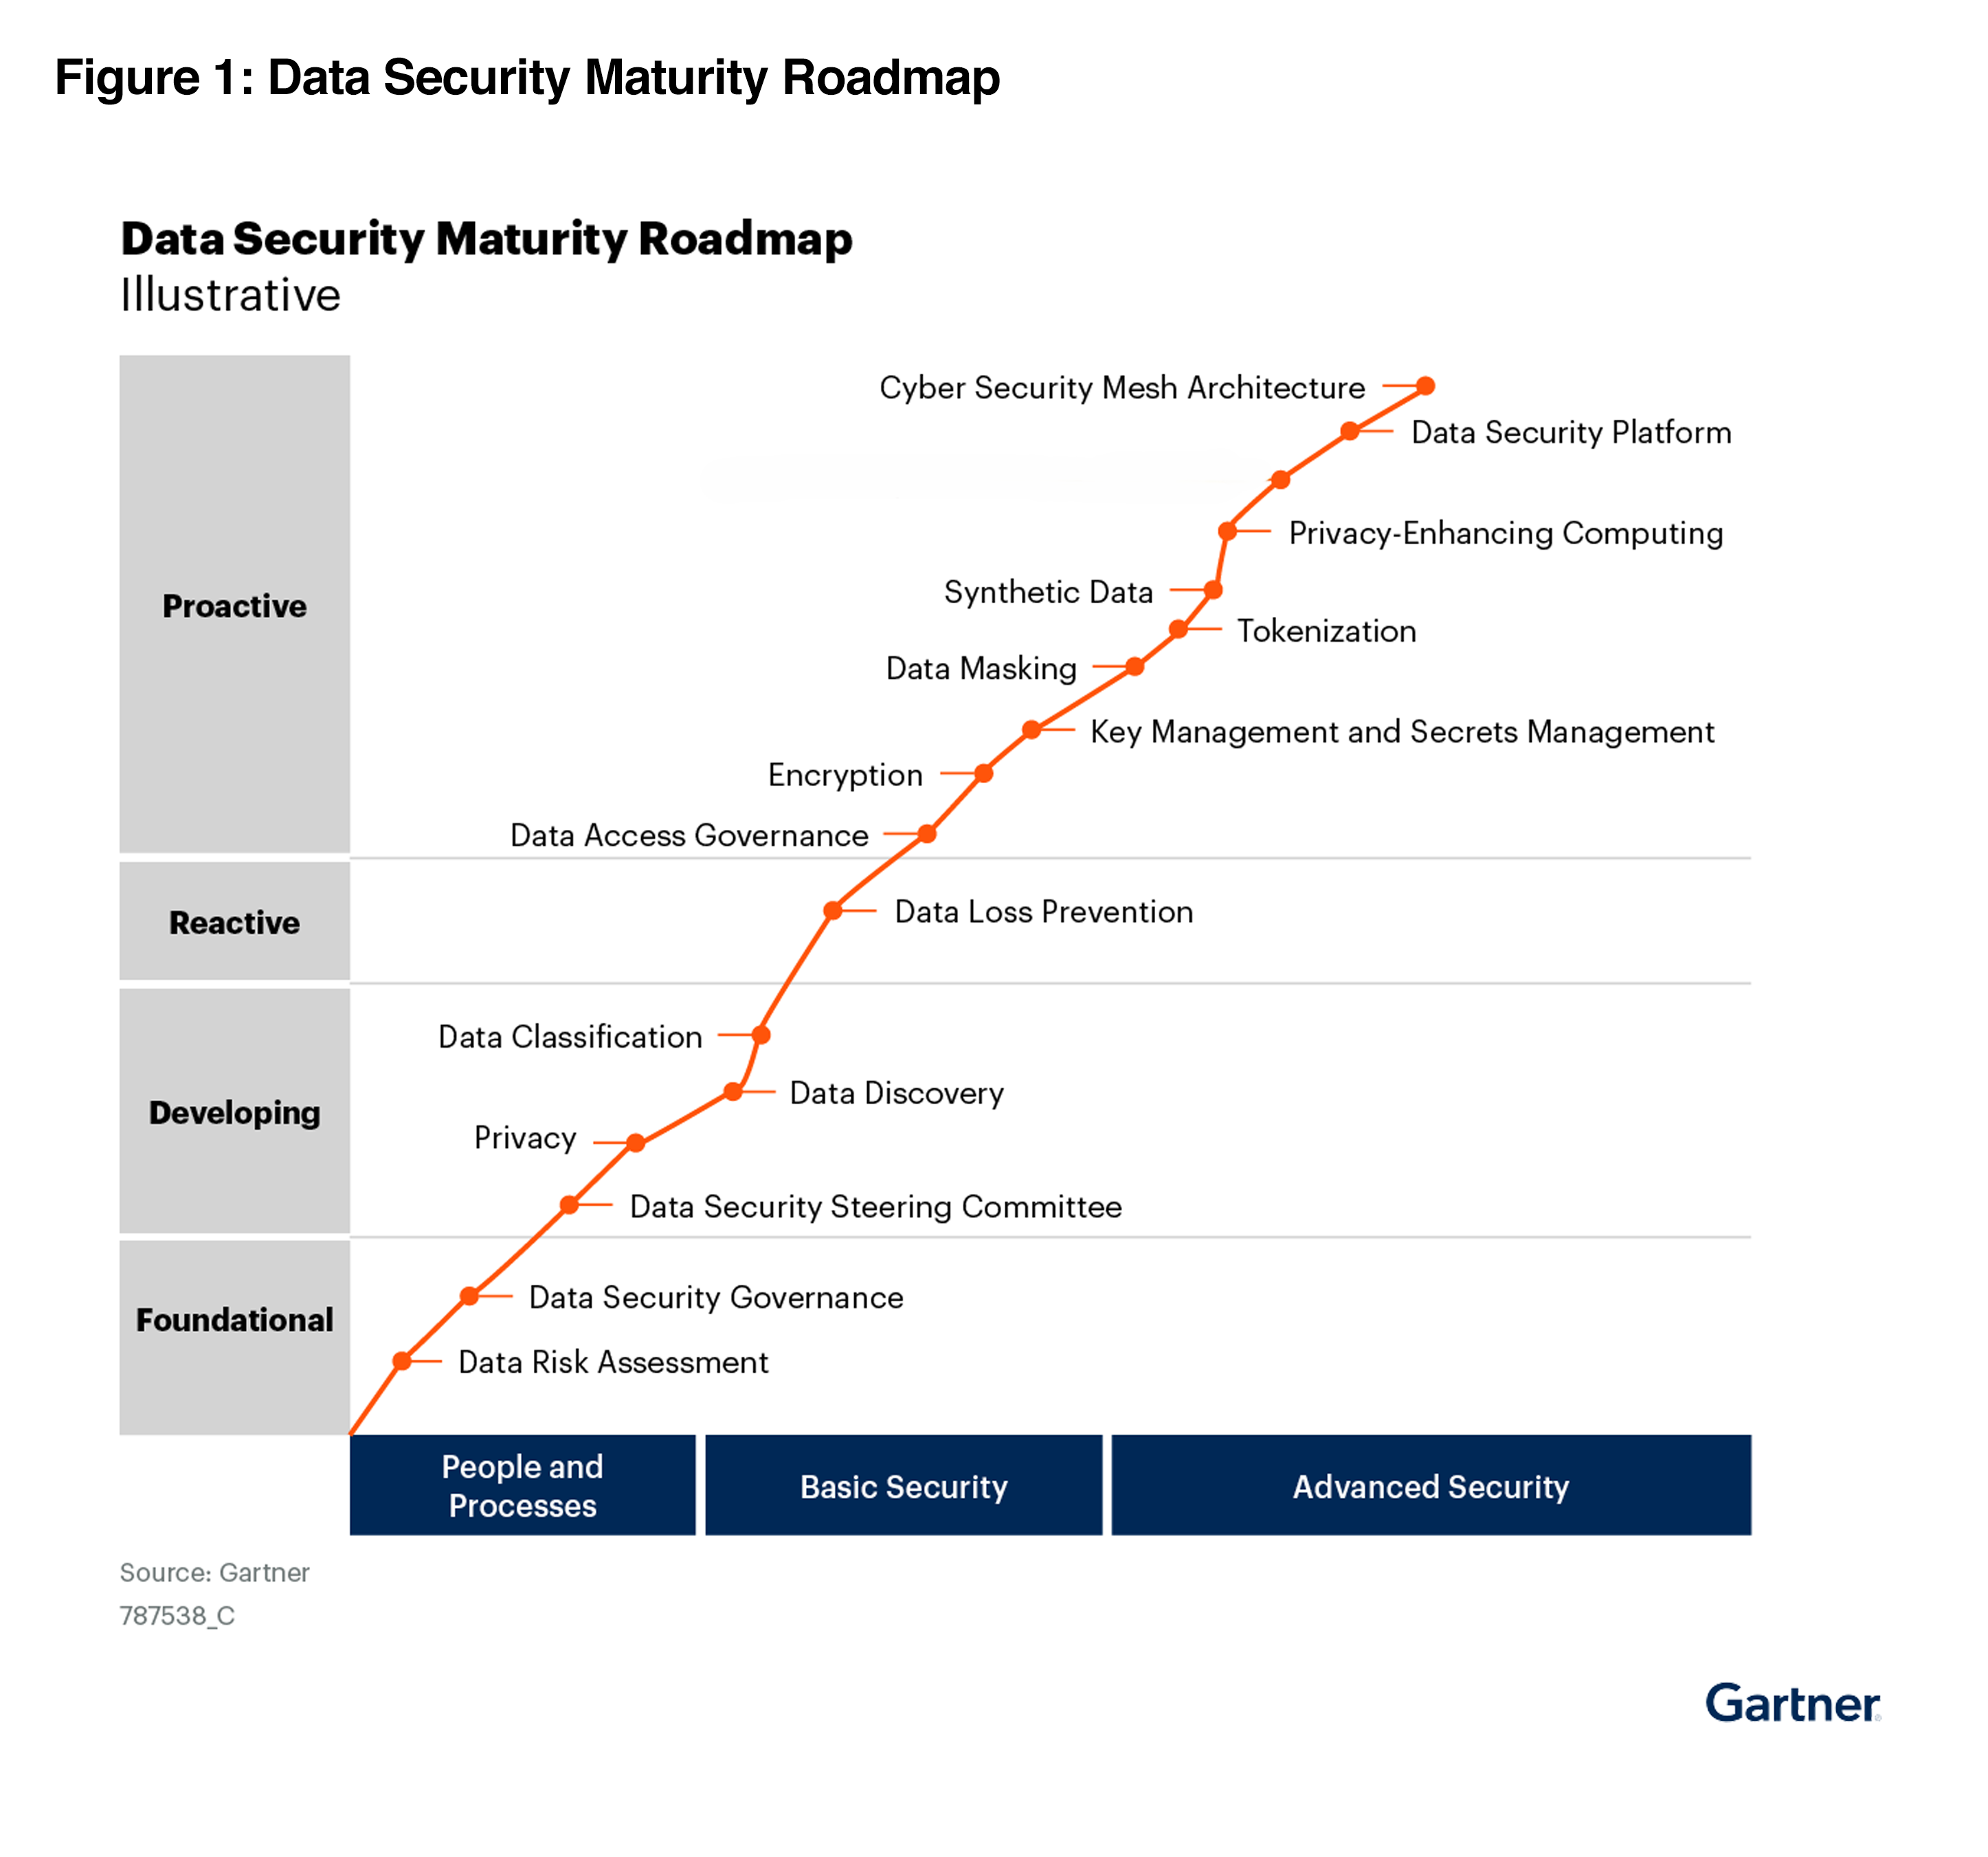

Slide 11
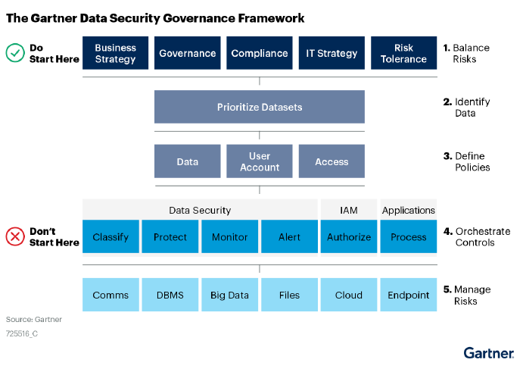
Foundational Level
Data Risk Assessment
Data Security Governance
provides valuable insights into the organisation’s data security landscape, by identifying potential risks
prioritise investments and efforts to mitigate those risks and protect sensitive information effectively

Slide 13



Developing Level
Data Security Steering Committee
Data Discovery
& Classification
Privacy
involves establishing a governing body responsible for overseeing and guiding data security initiatives within the organization.
establishing comprehensive measures to protect individuals' privacy rights and personal data under relevant regulations and standards
identifying and mapping ALL data assets
categorizing data based on its sensitivity, importance, and regulatory requirements
Notes:
Characteristics of an effective, high-level classification policy include the following:
■ It is short, and easy to parse.
■ It has no more than three to four classification levels and establishes a basis for the
business to understand degrees of sensitivity.
■ It is flexible, not draconian. It allows for controlled exceptions and supports
decisions that balance protection with business needs.
■ It avoids references to technology, departments, and data types that age.

Slide 15

Notes:
Data Loss Prevention – involves implementing technologies and processes to protect sensitive data from unauthorized access, disclosure, or leakage, reducing the risk of data breaches and regulatory non-compliance.
Data Loss Prevention (DLP) can be significantly enhanced by data discovery and classification because these processes provide a deeper understanding of the data landscape within an organization.
Data Loss Prevention (DLP) can be significantly enhanced by data discovery and classification because these processes provide a deeper understanding of the data landscape within an organization. Here’s how:
1. Identifying Sensitive Data:
Data Discovery: Locating all data across the organization, including structured and unstructured data in various storage locations.
Classification: Categorizing data based on its sensitivity and importance, such as confidential, internal, public, or regulated data.
Benefit to DLP: By knowing where sensitive data resides and how it is classified, DLP systems can apply targeted and appropriate protection measures.
2. Prioritizing Protection:
Classification Levels: Assigning different levels of security based on the classification of the data.
Benefit to DLP: Ensures that more stringent controls are applied to high-risk data, reducing the likelihood of data breaches and leaks of critical information.
3. Enhancing Detection Accuracy:
Data Patterns: Understanding the structure and patterns of sensitive data types.
Benefit to DLP: Improves the accuracy of DLP detection mechanisms by enabling them to recognize and protect sensitive data more effectively, reducing false positives and negatives.
4. Improving Policy Enforcement:
Tailored Policies: Creating DLP policies that are specific to different types of data based on their classification.
Benefit to DLP: Ensures that policies are more precise and relevant, enhancing the overall effectiveness of data protection strategies.
5. Streamlining Compliance:
Regulatory Mapping: Aligning data classification with regulatory requirements (e.g., GDPR, HIPAA).
Benefit to DLP: Facilitates compliance by ensuring that regulatory obligations are met through appropriate DLP controls on classified data.
6. Facilitating Incident Response:
Incident Analysis: Providing context about the type and sensitivity of data involved in an incident.
Benefit to DLP: Enhances the ability to respond to and remediate data loss incidents by quickly identifying the impact and required actions based on data classification.
7. Resource Optimization:
Focused Efforts: Directing resources and efforts toward protecting the most critical and sensitive data.
Benefit to DLP: Ensures that DLP efforts are cost-effective and impactful, avoiding the wastage of resources on less critical data.
In summary, data discovery and classification provide the foundational knowledge needed to effectively apply DLP measures. By knowing what data exists, where it is located, and how sensitive it is, organizations can implement more precise, effective, and efficient DLP strategies.

Slide 16

Notes:
Before we embark on introducing the proactive elements of the Data Security Maturity Roadmap, it is imperative that we first complete the foundational, developing, and reactive steps. These initial stages lay the groundwork for a robust data security posture by addressing essential aspects such as establishing policies, implementing basic data security controls, and developing incident response capabilities. Once these elements are in place and functioning effectively, we can then transition to implementing proactive measures aimed at preventing data security breaches and mitigating potential risks before they escalate. By following this systematic approach, we can ensure a comprehensive and strategic approach to enhancing our organization's data security posture.
The main purpose of the proactive level in data security maturity is to anticipate, prevent, and prepare for potential security threats before they occur by implementing advanced measures and continuous improvements. At this level, organizations employ a range of techniques and technologies, including data masking, key and secrets management, tokenization, and synthetic data generation.
Incorporating these advanced techniques at the proactive level ensures a comprehensive and forward-thinking approach to data security. This proactive stance significantly enhances an organization’s ability to protect sensitive data, anticipate threats, and quickly adapt to new security challenges.

Slide 17


How well are we prepared to protect it?
Notes:
Data acts as the lifeblood of modern businesses, crucial for survival and growth. Just as maintaining optimal blood health is vital for our well-being, ensuring the seamless flow and security of data is essential for business resilience and success. With DSPM solutions, businesses can safeguard their data, enabling resilience, agility, and prosperity in today's competitive landscape.
But the true challenge is yet to come…

Slide 18



Thank You!
E-mail: agatacrowley85@gmail.com
M: 085 2067696

